Slide 1

Election Prediction
DSC 540
GROUP 4
AMY AUMPANSUB, CHARLES BRANTLEY, MARKUS OLSON, SARAH DANIELSON
DETERMINING THE OUTCOME OF THE PRESIDENTIAL ELECTION BY COUNTY

Slide 2


ABSTRACT & INTRODUCTION
Overview
Every voter has his/her own expectations for a political party and candidate.^{[1]} Therefore, the parties need to effectively identify their potential voters to maximize the effectiveness of their campaigns and their success rate
Identifying the important political factors and characteristics of potential voters that contribute to winning an election can help politicians to connect and better engage with voters, thereby increasing their chances of winning the election ^{[2]}
Objective
Build strong classifiers to predict the presidential election outcome and winner based on the political factors and demographic features of voters
Rank and identify the important political factors and characteristics of voters who are likely to vote for Republican or Democratic candidates, which can help political parties increase their probability of winning the election
Questions to Answer
What variables overall are most important to predicting the outcome of an election?
What role, if any, do demographic characteristics play in the outcome of an election?

Slide 3
METHODOLOGY
In this presentation, we will walk you through the results of the following machine learning algorithms we used:
Logistic Regression
Decision Tree
Random Forest
K-Nearest Neighbors
Support Vector Machine
One target attribute
0→ Republican
1→ Democrat
Training data
Independent attributes
159 attributes
Political factors
Voter characteristics
Fit
ML classification algorithm
Predict
Test data
Models
Republican (“0”)
Democrat (“1”)

Slide 4
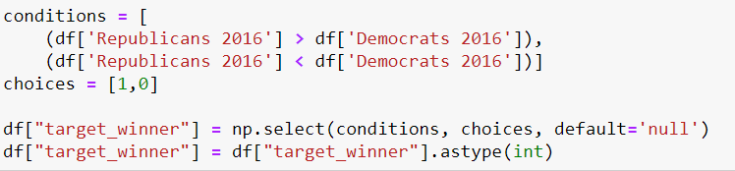
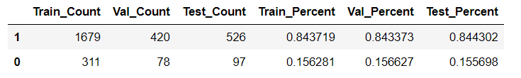
Data Preprocessing
Original file = 3143 x 159
149 numeric; 10 object
Construct Target Feature
Drop unrelated columns
Create the same target feature for previous years
Filled 6624 null values
Final = 3111 x 48
Stratified 5 fold split
Standard Scaler

Slide 5
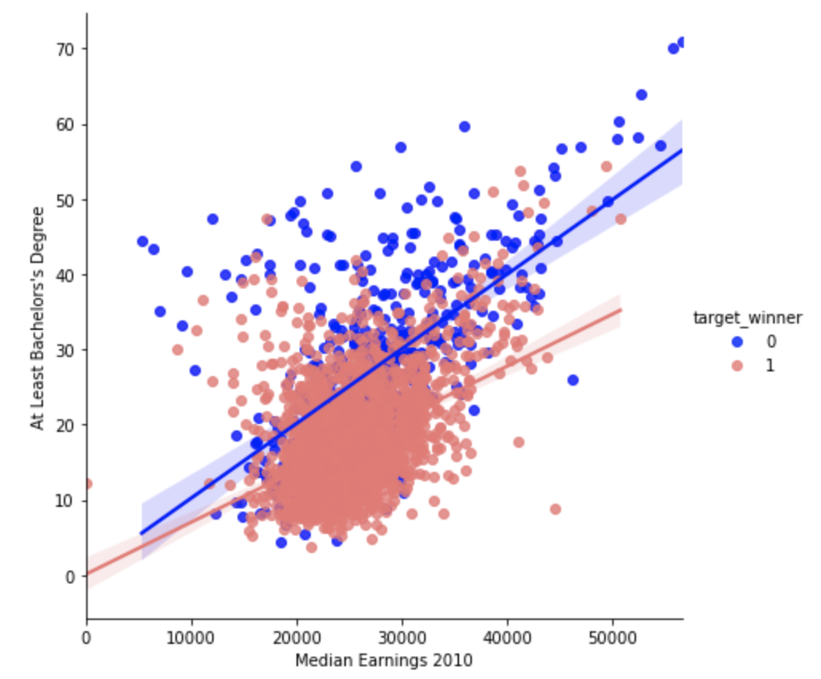
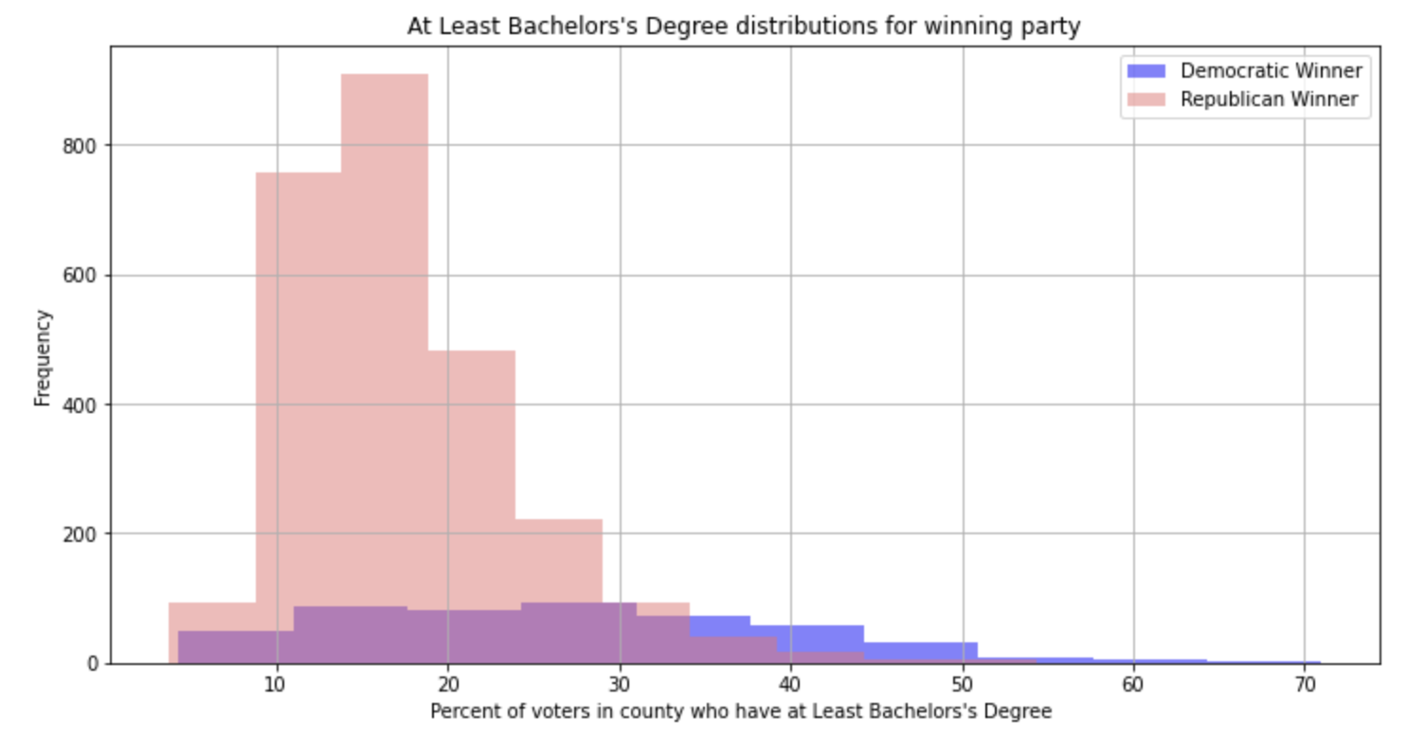
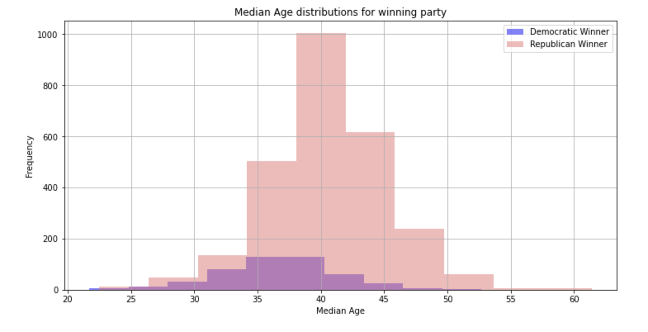

Data Exploration
The election results in 2008 and 2012 were highly correlated
We looked at individual county vote totals rather than by population
We noticed some differences in county demographics between those that voted Republican and those that voted Democratic

Slide 6
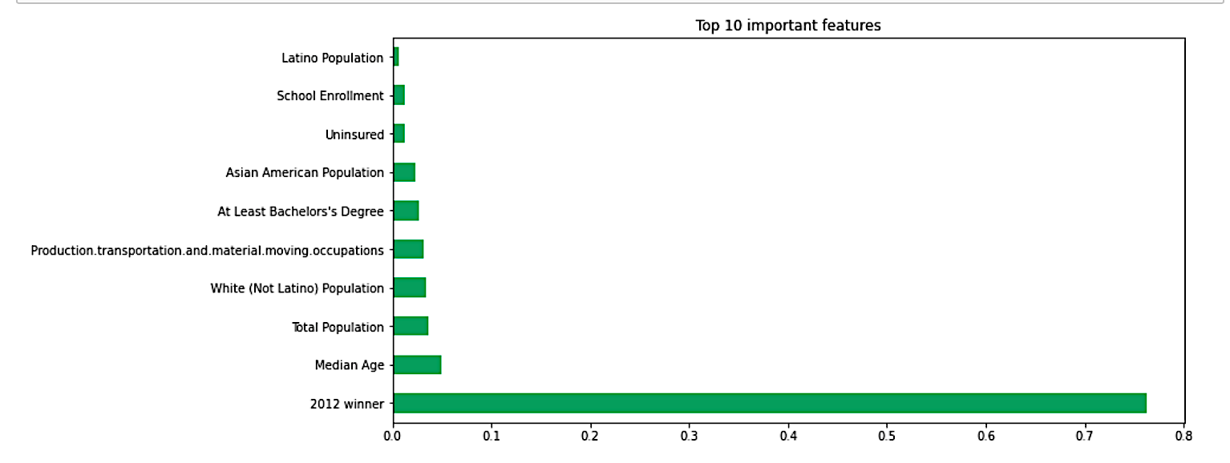
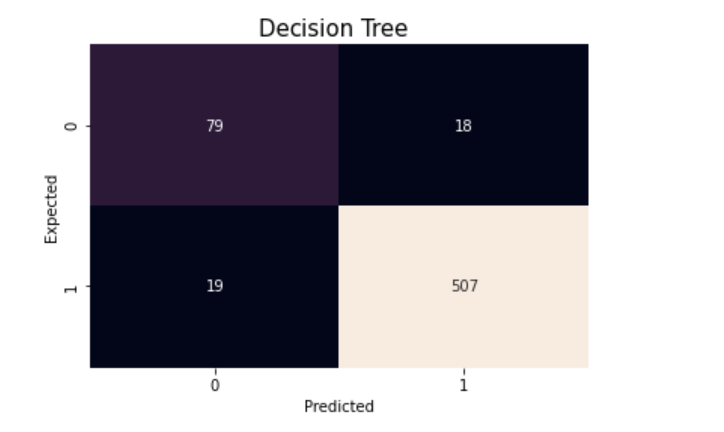
Decision Tree
Fitted with 44 features
Demographic Factors, Previous election result, Surroundings of county factors
Best Model:
class_weight= {0: 2, 1: 1}, criterion ='entropy', max_depth=5, min_samples_split=50
Important Features:
Accuracy 94%
Specificity 81% Sensitivity 96%
F1 96% Precision rate 97%
2012 Winner > Age > Race > Education

Slide 7
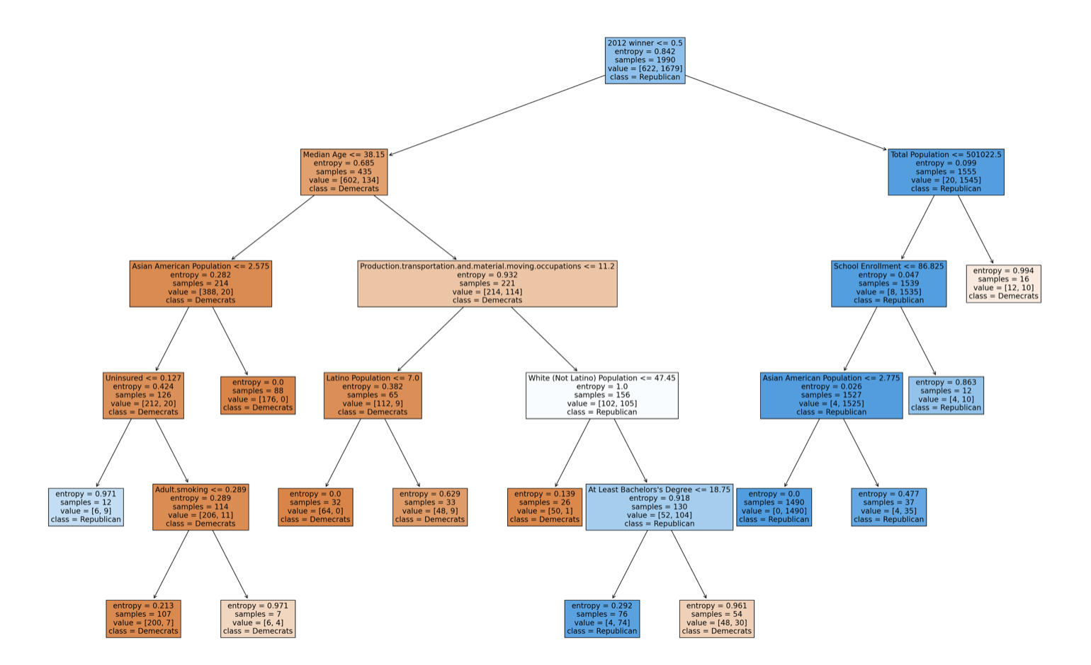
Decision Tree
Example of classification rules:
1. If 2012 winner <= 0.5 & Median age <= 38.15
& Total Asian American pop > 2.5%,
The Democratic candidate is predicted to win
The Most Important Feature
1.

Slide 8
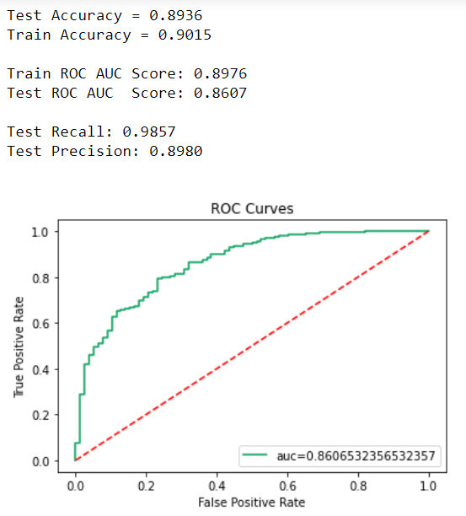
Logistic Regression
Performs nicely for a basic model.
Still room for improvement!

Slide 9
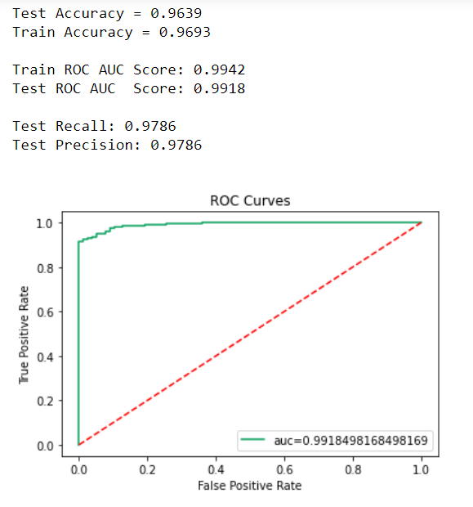
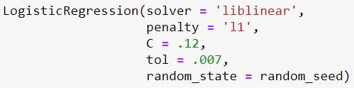
Logistic Regression
Tuning
Randomized search
Grid search

Slide 10
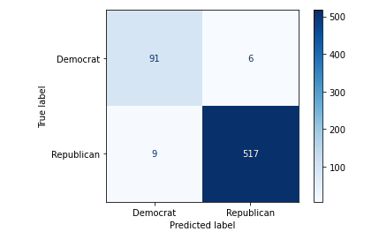
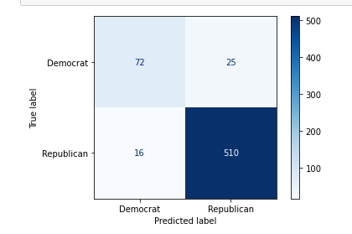
Random Forest
Default Model
First go around just ran Random Forrest on the data set with out tuning any of the parameters
Default Model Scores:
Training Accuracy = 1.000
Testing Accuracy = 0.976
Recall = 0.983
Precision = 0.989
Balanced Accuracy = 0.961
F1 Score = 0.986
Default
Optimized
Optimized Model
Training Accuracy = 0.957
Testing Accuracy = 0.934
Recall = 0.970
Precision = 0.953
Balanced Accuracy = 0.856
F1 Score = 0.961

Slide 11
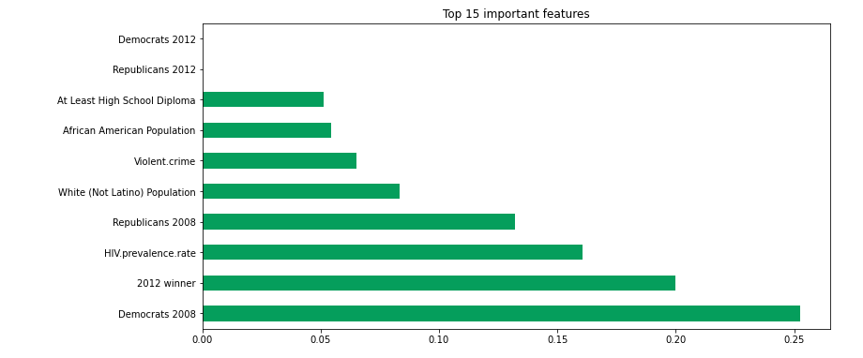
Random Forest Important Variables
Previous winners were important
Race also and indicator
Violent Crimes and HIV rate were interesting.

Slide 12
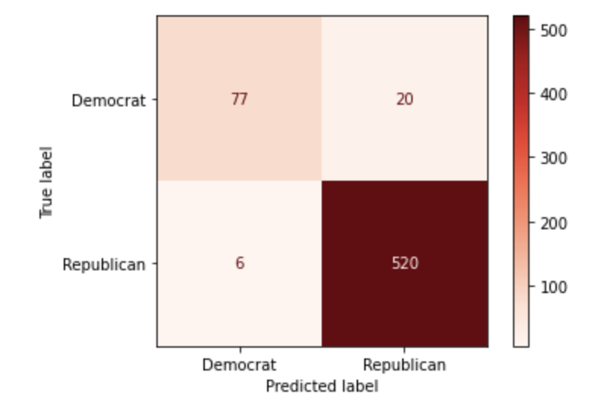
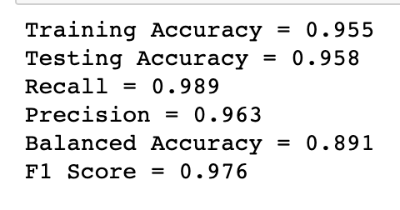
K-Nearest Neighbors
The best value of k was found to be k = 35
Initial results using this k-value were good, but hopefully could be improved by using grid search

Slide 13
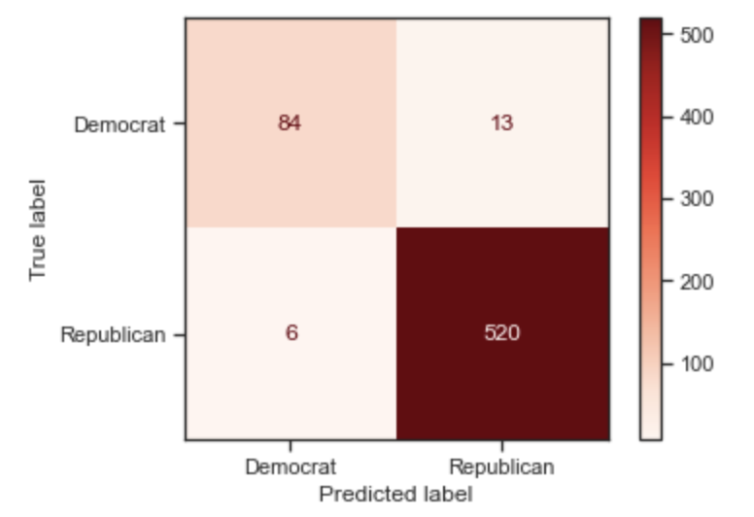
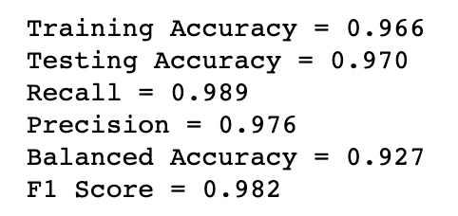
K-Nearest Neighbors
After completing grid search, best parameters were found to be using Manhattan distance, 15 neighbors, and uniform weights
Feature importance using permutation importance found that 2012 winner, 2008 winner, infant mortality, African American population, and median age were the top 5 most influential variables

Slide 14
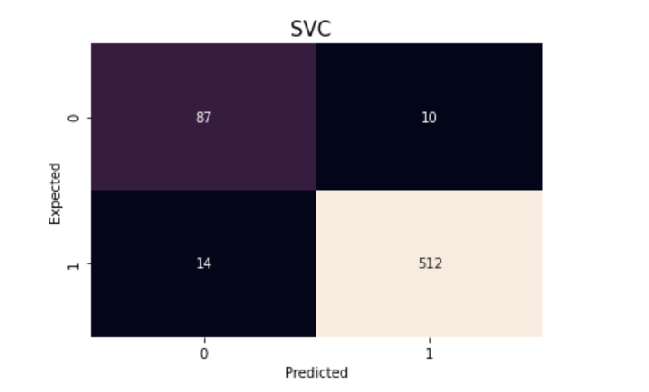
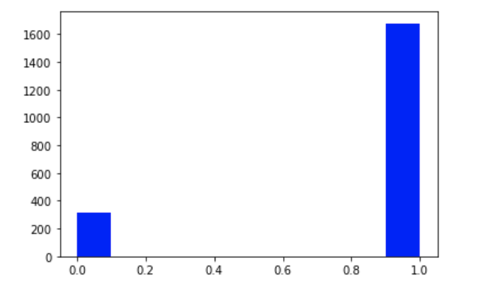
SVC
Support Vector Classifier with Fitted with Standardized value and Kernel PCAs
Hyperparameter tuning on C and Gamma
The Best Model:
kernel ='rbf’, C =1000, Gamma= 0.0001, class_weight = {0: 3, 1: 0.5}
Confusion Matrix
Model Performance
Overall Accuracy 96%
Specificity 90% Sensitivity 97%
F1 98% Precision rate 98%
Assign more weight for class 0 (Minority) than class 1

Slide 15
Conclusion & Research Outcomes
What variables overall are most important and least important to predicting the outcome of an election?
Model Summary
Feature Importance
SVC with kernel RBF performs the best
All models have high accuracy rate, F1, sensitivity over 90-95%
Adjusting class weight to put more emphasis on the minority class has significantly improved the specificity (increase over 7%)
All models are not overfitting as the accuracy rates of training and test sets are closed to each other (less than 1.5% gap)
The most important feature: the previous election results in 2012.
Demographic features related to race, education level, and median age also have a high influence on the election outcome
County factors such as crime rate has less influence on the election outcome

Slide 16
References
Dataset retrieved from:
https://public.opendatasoft.com/explore/dataset/usa-2016-presidential-election-by-county/table/?disjunctive.state.
[1] Pew Research Center: An examination of the 2016 electorate, based on validated voters August, 2018 retrieved from https://www.pewresearch.org/politics/2018/08/09/an-examination-of-the-2016-electorate-based-on-validated-voters/
[2] Kurtbus I., The Factors Influencing Voting Preferences in Local Elections An Empirical Study. International Journal of Humanities and Social Science. Sep, 2015 retrieved from https://www.researchgate.net/publication/295095195_The_Factors_Influencing_Voting_Preferences_in_Local_Elections_An_Empirical_Study

